Slide 1

A Major Project Presentation on
AUTOMATIC DETECTION OF
BLOOD CANCER FROM MICROSCOPIC IMAGES in Partial Fulfillment for Third Year Computer Engineering Course- Seminar and Technical Communication Name (PRN No.)
Sejal Kotkar : 121B1D031
Charul Chim : 121B1D055
Sanika Mendukale : 121B1D077
(A. Y. 2024-2025)
Under the guidance of
Prof. ANANDKUMAR BIRAJDAR Department of Computer Engineering PCET’s Pimpri Chinchwad College of Engineering

Slide 2
Contents
Introduction
Problem Definition
Motivation
Objective
Literature Survey
Software Requirement Specification
Algorithm
Dataset
Project Plan
Software Testing
Results
Contribution to Sustainable Development Goals
Future Scope
Conclusion
References

Slide 3
Introduction
This study presents a system for early detection of blood cancer using MobileNet, a lightweight deep learning model. Microscopic blood smear images undergo preprocessing (noise removal, contrast enhancement, augmentation), and are split into training (70%), validation (15%), and testing (15%) sets. MobileNet is fine-tuned via transfer learning to classify samples into four stages: Benign, Malignant Early, Malignant Pre, Malignant Pro. The model achieves 93.58% accuracy, using RMSprop optimizer and early stopping. This approach ensures fast, accurate, and cost-effective diagnosis, aiming to support real-time clinical use with future enhancements like cloud integration and explainable AI.

Slide 4
Problem Statement
“Blood Cancer Detection Using Deep Learning on Microscopic Images”

Slide 5
Motivation, the scope of work
Motivation
Blood cancer diagnosis is complex and requires expert analysis of microscopic samples.
Early detection significantly improves treatment outcomes and survival rates.
System ensures faster, more accurate, and consistent blood cancer diagnosis.
Scope of Work
Utilize microscopic blood smear images for model training and testing.
Apply preprocessing techniques like noise removal, contrast enhancement, and data augmentation.
Implement MobileNet architecture with transfer learning for efficient feature extraction.

Slide 6
Objectives
Develop a system for accurate blood cancer detection using MobileNet.
Automate classification of blood smear images into different cancer stages.
Reduce diagnosis time and enhance early detection for better patient outcomes.
Minimize human error through consistent and standardized analysis.
Improve accessibility to reliable diagnostics in resource-limited or remote areas.

Slide 7
Literature Review
Rf No. | Title | Publish Year | Methodology | Findings
1. | A Hybrid Feature Fusion Deep Learning Framework for Leukemia Cancer Detection in Microscopic Blood Sample Using Gated Recurrent Unit and Uncertainty Quantification | 2024 | This study integrates InceptionV3, EfficientNetB3, and MobileNetV2 with Gated Recurrent Units (GRU) for classifying Acute Lymphoblastic Leukemia (ALL) from microscopic blood images. Bayesian optimization and Deep Ensemble uncertainty quantification enhance accuracy and reliability. | The study achieved up to 100% accuracy using a hybrid model (InceptionV3, EfficientNetB3, MobileNetV2, GRU) with Bayesian optimization.
2. | DVS: Blood Cancer Detection Using Novel CNN-Based Ensemble Approach (2024) Methodology | 2024 | This research evaluates VGG19, ResNet152v2, SEresNet152, ResNet101, and DenseNet201 for blood cancer classification, introducing an ensemble model (DVS) that combines DenseNet201, VGG19, and SEresNet152 for better performance. | The DVS model (DenseNet201, VGG19, SEresNet152) achieved 98.76% accuracy, outperforming single CNNs.

Slide 8
Rf. No | Title | Publish Year | Methodology | Findings
3. | A2M-LEUK: attention-augmented algorithm for blood cancer detection in children | 2023 | The study introduces A2M-LEUK integrates attention-based machine learning with deep learning for leukemia detection in microscopic blood images. Preprocessing techniques like data augmentation enhance accuracy. The model achieves 99.98% accuracy, with 99.97% precision, 100% recall, and a 99.99% F1-score, ensuring effective classification of leukemia cells in children. | The model achieved 99.98% accuracy, with 99.97% precision, 100% recall, and a 99.99% F1-score, ensuring effective classification of leukemia cells in children.
4. | Using deep learning on microscopic images for white blood cell detection and segmentation to assist in leukemia diagnosis | 2025 | This study integrates PCA for dimensionality reduction and YOLOv10 for real-time white blood cell classification. Using six public datasets and advanced augmentation, the Y-YOLOv10 model achieved 96.85% accuracy, surpassing YOLOv8 and ResNet50. It reduces data size by 30–40%, enhancing leukemia diagnosis speed and easing specialists' workload. | The Y-YOLOv10 model achieved a 96.85% accuracy, surpassing YOLOv8 and ResNet50. Additionally, data size was reduced by 30–40%, enhancing leukemia diagnosis speed and easing specialists’ workload.

Slide 9
Software Requirement Specification
1. Code Editor & Development Environment
VS Code – For efficient code writing and management
Google Colab – For developing and testing ML models in the cloud
2. Programming Languages & Libraries
Python – Core language for ML implementation
HTML, CSS, JavaScript– For frontend/web interface
TensorFlow & Keras - Build, train, preprocessing, augmentation, evaluation and prediction tasks.
NumPy – Data manipulation and preprocessing
3. Frameworks & Tools
Flask – Backend development and API integration
Matplotlib & Seaborn – Data visualization
RMSprop - To train model automatically

Slide 10
Algorithm & Dataset
Model: MobileNet using Depthwise Separable Convolutions for efficient image classification.
Preprocessing: Data augmentation (rotation, flipping, zooming), noise removal, and Canny Edge Detection for better feature extraction.
Training: Transfer learning with ImageNet weights, fine-tuned for blood cancer (Leukemia, Lymphoma, Myeloma).
Optimization: Adam optimizer, Categorical CrossEntropy loss, 50 epochs, batch size 32. Dataset - 8613 Total images divided into 4 category(Benign, Malignant Early, Malignant Pre, Malignant Pro)

Slide 11
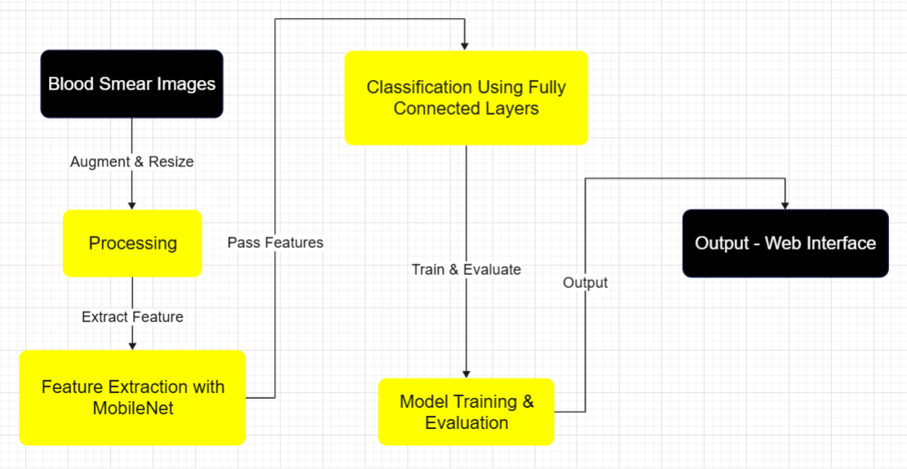
Architecture Diagram

Slide 12
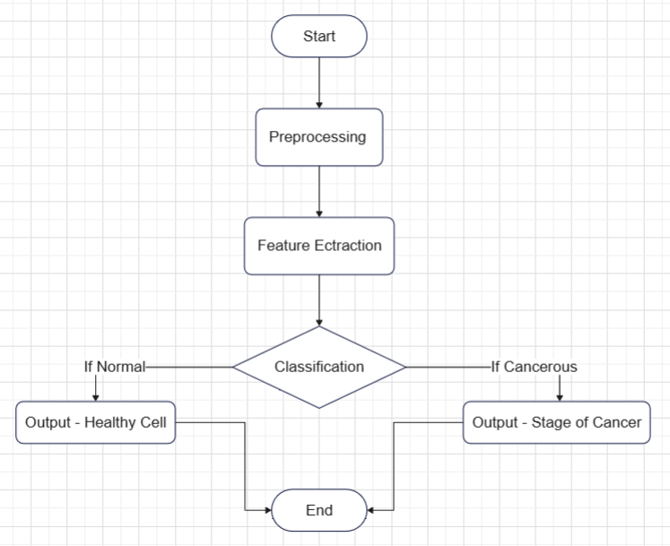
Flow Diagram

Slide 13
Complexity & Project Plan
Complexity of Project
The project is complex due to several factors. Image preprocessing involves techniques like noise removal, data augmentation, and edge detection for high-quality input. Fine-tuning the lightweight MobileNet architecture with transfer learning adds complexity. Handling a large, diverse dataset requires careful balancing during training to avoid overfitting. Integrating the model into a real-time medical system presents challenges in speed, accuracy, and compatibility for practical healthcare use.
Project Plan
Data Collection & Preprocessing – 1-2 Weeks
Gather and preprocess blood cancer images, applying augmentation and noise removal techniques.
Model Development & Training – 3-4 Weeks
Implement and fine-tune MobileNet with the preprocessed dataset using transfer learning.
Model Evaluation & Testing – 2 Weeks
Evaluate the model’s performance on testing data with metrics like accuracy, precision, and recall.
Integration – 1-2 Weeks
Integrate the trained model into a web interface for medical use and prepare for real-time deployment.

Slide 14
Software Testing
Unit Testing: Verified individual components like image preprocessing, model loading, and prediction logic using sample inputs to ensure accuracy at each step.
Integration Testing: Tested end-to-end flow from uploading an image, preprocessing, predicting with the trained MobileNet model, to displaying results to confirm module interaction.
Functional Testing: Ensured the system correctly identifies blood cancer types from microscopic images based on labeled data and expected output.
Performance Testing: Assessed model accuracy and efficiency on large image datasets, monitored training/validation time and memory usage.
Security Testing: Implemented secure handling of uploaded images and ensured no data leaks during model inference or logging.
User Acceptance Testing (UAT): Collected feedback from potential users (students/professors) to confirm the system is easy to use and delivers meaningful results.

Slide 15
Contribution to Sustainable Development Goals
Good Health and Well-being (SDG 3): Enhances early detection and diagnosis of blood cancer, improving health outcomes.
Industry, Innovation, and Infrastructure (SDG 9): Promotes innovation in healthcare through AI-driven diagnostic tools.
Reduced Inequality (SDG 10): Increases access to accurate cancer diagnosis, especially in underserved areas.
Partnerships for the Goals (SDG 17): Encourages collaboration between healthcare professionals and tech developers to improve healthcare systems.

Slide 16
Result
The results of the project demonstrate the effectiveness of the AI-powered model in detecting blood cancer stages. The MobileNet-based model achieved an accuracy of 93.58%, showcasing high precision in classifying blood samples into different stages: Benign, Malignant Early, Malignant Pre, and Malignant Pro. The model’s performance was evaluated using key metrics such as precision, recall, and F1-score, all of which indicate strong reliability in detecting and classifying blood cancer stages accurately. These results highlight the potential of the model to assist medical professionals in providing faster, more accurate diagnoses, ultimately improving patient outcomes.

Slide 17
Conclusion
The AI-powered system offers fast, reliable blood cancer detection using MobileNet and deep learning. It supports early diagnosis, reduces manual errors, and enhances clinical decision-making. Capable of handling large datasets, the system ensures scalability and smooth performance. With automated reports, real-time results, and an intuitive UI, it streamlines workflows for healthcare professionals. Strong security measures protect patient data, making the system ideal for hospitals, labs, and telemedicine. This innovation highlights the growing impact of AI in transforming medical diagnostics.

Slide 18
References
1. Ferreira, Fernando Rodrigues Trindade, and Loena Marins do Couto. "Using deep learning on microscopic images for white blood cell detection and segmentation to assist in leukemia diagnosis." The Journal of Supercomputing 81.2 (2025): 1-42.
2. Shehta, A.I., Nasr, M. & El Ghazali, A.E.D.M. Blood cancer prediction model based on deep learning technique. Sci Rep 15, 1889 (2025).
3. Al-Obeidat F, Hafez W, Rashid A, Jallo MK, Gador M, Cherrez-Ojeda I and SimancasRacines D (2025) Artificial intelligence for the detection of acute myeloid leukemia from microscopic blood images; a systematic review and meta-analysis. Front. Big Data 7:1402926. doi: 10.3389/fdata.2024.1402926.
4. Ahad, Md Taimur, et al. "Dvs: Blood cancer detection using novel cnn-based ensemble approach." arXiv preprint arXiv:2410.05272 (2024).
5. Krizhevsky, A., Sutskever, I., & Hinton, G. E. (2012). ImageNet classification with deep convolutional neural networks. Advances in Neural Information Processing Systems.

Slide 19
Thank you

